Slide 1
Insertion sort

Slide 2
introduction
Insertion sort is a simple sorting algorithm that works similar to the way you sort playing cards in your hands.
The array is virtually split into a sorted and an unsorted part.
Values from the unsorted part are picked and placed at the correct position in the sorted part.

Slide 3
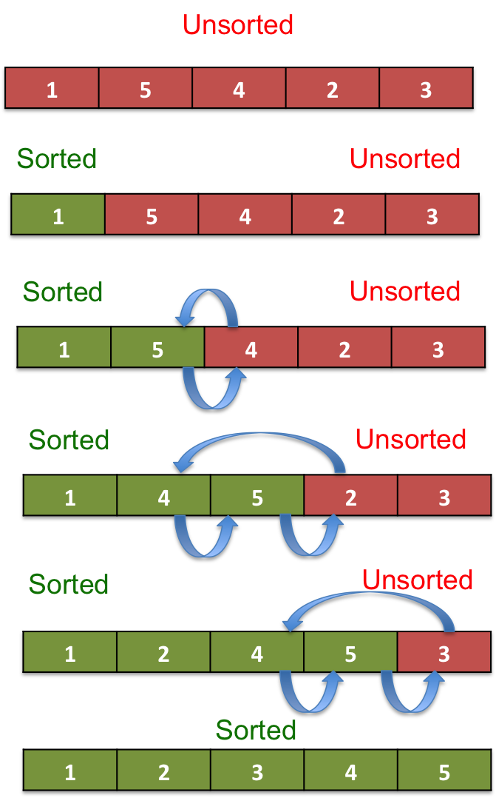
How it works

Slide 4
Algorithm
Step 1 − If it is the first element, it is already sorted. return 1;
Step 2 − Pick next element
Step 3 − Compare with all elements in the sorted sub-list
Step 4 − Shift all the elements in the sorted sub-list that is greater than the value to be sorted
Step 5 − Insert the value
Step 6 − Repeat until list is sorted

Slide 5
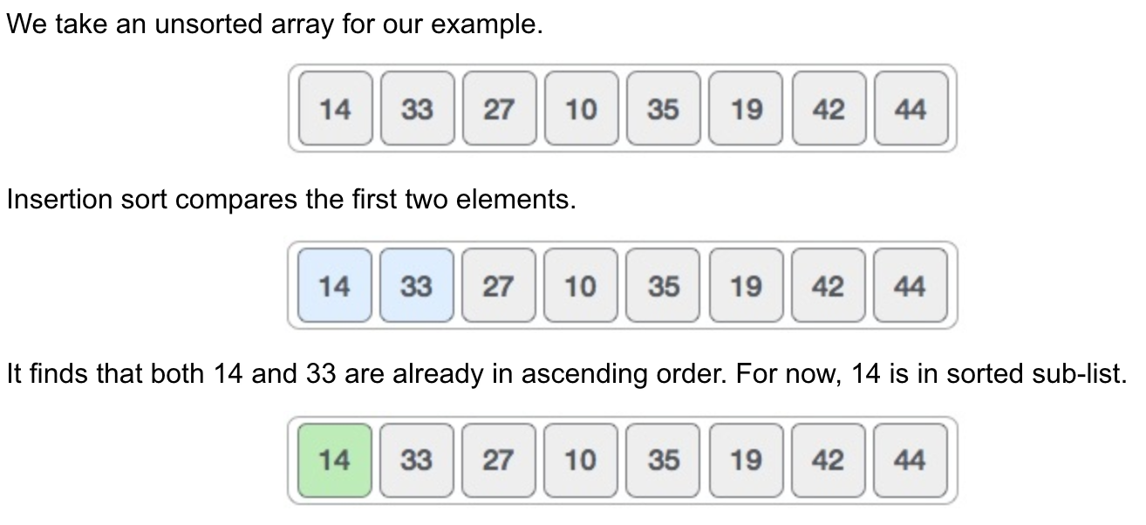
Illustration

Slide 6
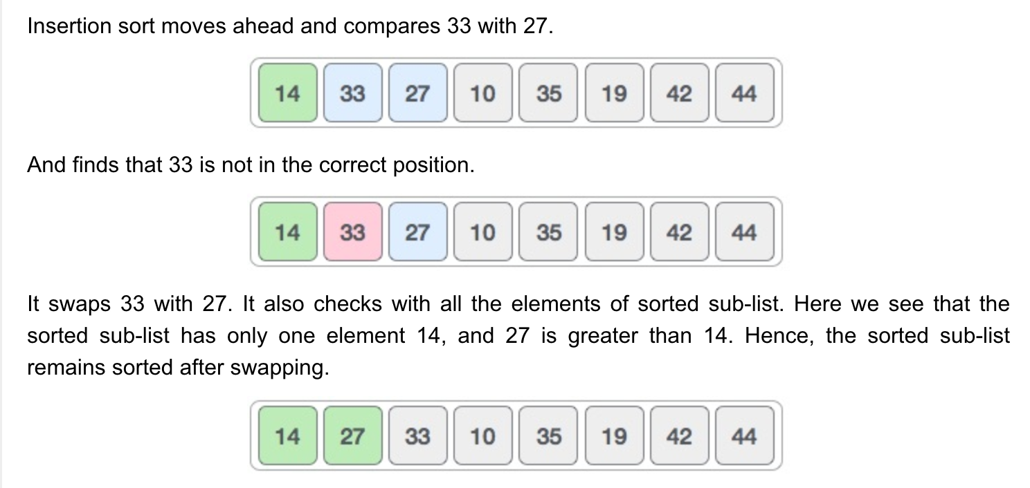

Slide 7
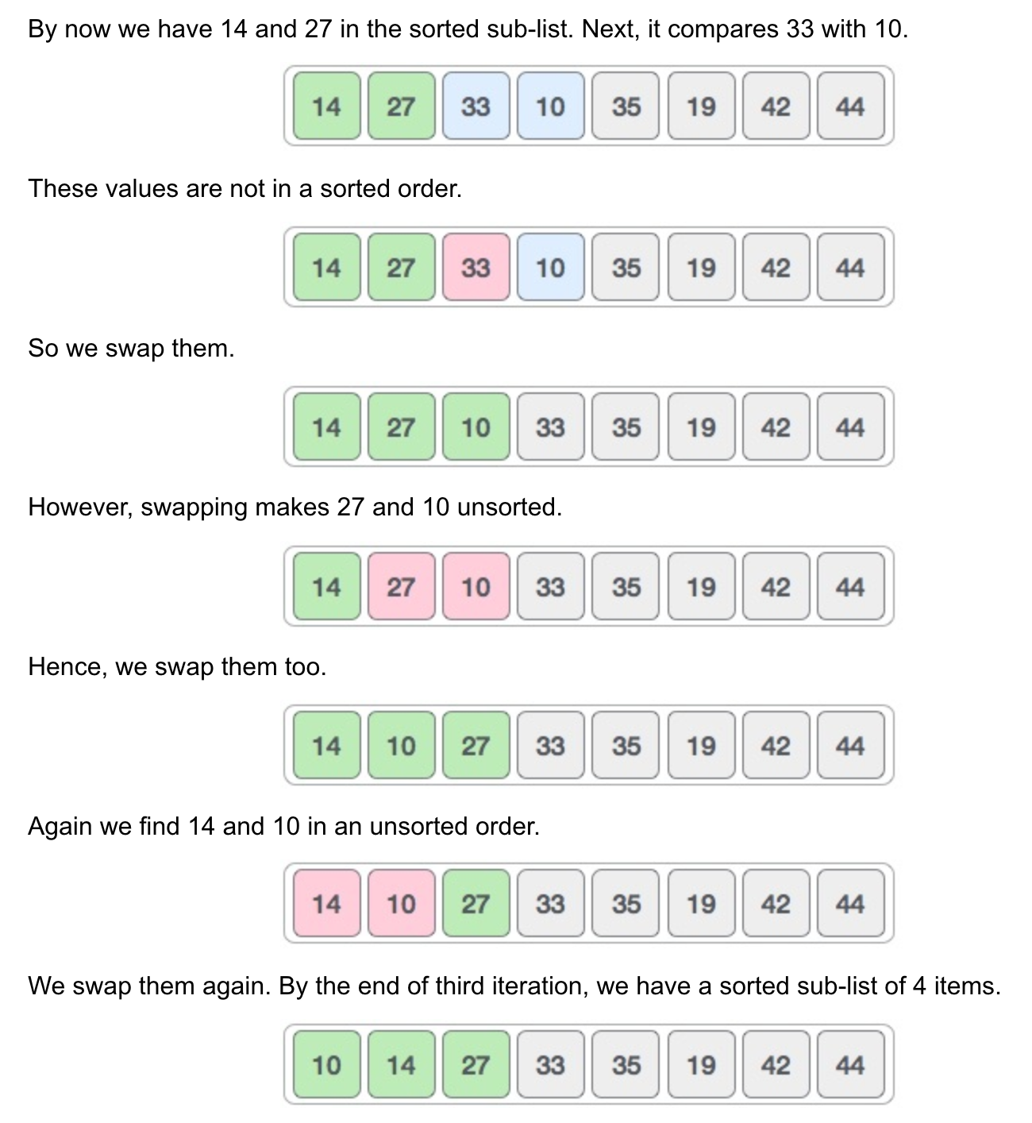

Slide 8
Properties
Stable Sort
In the worst case we make one comparison for the second element, two for the third element and so on. We end up with O(n^2) comparisons and swaps
In the best case i.e. when array is already sorted, we get O(n) comparisons. Thus, Insertion sort is adaptive.
This algorithm is not suitable for large data sets as its average and worst case complexity are of Ο(n²), where n is the number of items.

Slide 9
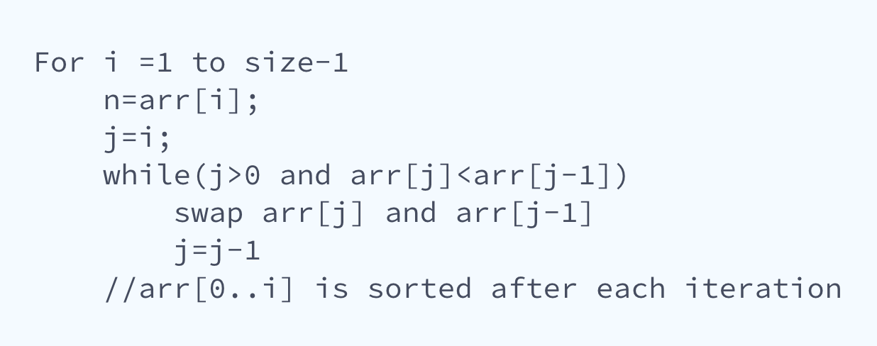
Pseudocode

Slide 10

QUESTIONS??

